Slide 1
11
Project Analysis and Evaluation

Slide 2

Chapter 11 – Index of Sample Problems
Slide # 02 - 05 Scenario analysis
Slide # 06 - 10 Sensitivity analysis
Slide # 11 - 12 Total cost
Slide # 13 - 14 Average vs. marginal cost
Slide # 15 - 16 Contribution margin
Slide # 17 - 20 Accounting break-even
Slide # 21 - 24 Cash break-even
Slide # 25 - 26 Financial break-even
Slide # 27 - 30 Degree of operating leverage

Slide 3
2: Scenario analysis
Wilson’s Woods is considering a project which involves producing inexpensive golf clubs for teenagers. The company expects to sell these clubs for $100 a set, plus or minus 2%. The sales manager estimates that 20,000 sets can be sold, plus or minus 5%.
What is the expected amount of sales under the worst case scenario?

Slide 4
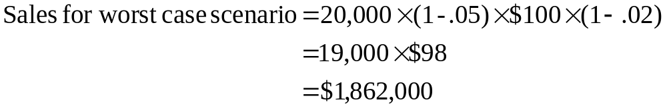
3: Scenario analysis

Slide 5
4: Scenario analysis
Bob’s Custom Wheels is considering designing and selling customized steering wheels for hot rods. The projected fixed costs of this project are $18,000. Variable costs are estimated at $54.90 per wheel. The cost estimates are considered accurate within a plus or minus range of 5%. The depreciation expense is $8,000 per year. Bob’s expects to sell 1,500 wheels, plus or minus 3%. The sales price is estimated at $139.00, plus or minus 5%.
What is the projected earnings before interest and taxes under the best case scenario?

Slide 6
5: Scenario analysis
Note: Totals are rounded to whole dollars.
Sales = 1,500 × (1 + .03) × $139.00 × (1 + .05) = $225,493
Variable cost = 1,500 × (1 + .03) × $54.90 × (1 - .05) = $ 80,579
Fixed cost = $18,000 × (1 - .05) = $ 17,100
Depreciation = $8,000 = $ 8,000 EBIT = $119,814

Slide 7
6: Sensitivity analysis
Kettle Corn and Chips is considering selling snack foods at sporting events. The company has developed the following estimates:
Sales 25,000 units ± 10%
Variable cost $.59 per unit ± 5%
Fixed cost $7,500 ± 2%
Selling price $1.25 per unit ± 5%
Depreciation $1,000
What is the earnings before interest and taxes for a sensitivity analysis using a variable cost of $.60 per unit?

Slide 8
7: Sensitivity analysis
Note: Totals are rounded to whole dollars.
Sales = 25,000 × $1.25 = $31,250
Variable cost = 25,000 × $.60 = $15,000
Fixed cost = $7,500 = $ 7,500
Depreciation = $1,000 = $ 1,000 EBIT = $ 7,750

Slide 9
8: Sensitivity analysis
The Sweet Shoppe is considering opening a kiosk and selling homemade cookies on the waterfront during tourist season. The company has developed these estimates:
Sales 6,000 cookies ± 20%
Variable costs $.69 per cookie ± 4%
Fixed costs $500 ± 3%
Sales price $1.10 ± 5%
Depreciation $800
Tax rate 34%
What is the operating cash flow for a sensitivity analysis using a sales quantity of 6,500 cookies?

Slide 10
9: Sensitivity analysis
Note: Totals are rounded to whole dollars.
Sales = 6,500 × $1.10 = $7,150
Variable cost = 6,500 × $.69 = $4,485
Fixed cost = $500 = $ 500
Depreciation = $800 = $ 800
EBIT = $1,365
Tax = .34 × $1,365 = $ 464
Net income = $ 901
OCF = EBIT + Depreciation – Taxes
= $1,365 + $800 - $464 = $1,701

Slide 11
10: Sensitivity analysis
OCF = [(Sales – Costs) × (1 – Tax rate)] + [Depreciation × tax rate]
= {[6,500 × ($1.10 - $.69)] - $500}× {1 - .34} + {$800 × .34}
= $1,428.90 + $272.00
= $1,700.90
= $1,701 (rounded to whole dollars)

Slide 12
11: Total cost
Sandwiches To Go sells 500 sandwiches per day. The company pays $1,200 a month for rent. Other fixed costs are $500 monthly.
The variable cost per sandwich is $2.89. Assume a month has 30 days.
What are the monthly total costs incurred by Sandwiches To Go?

Slide 13
12: Total cost
Total monthly cost = (500 × 30 × $2.89) + $1,200 + $500
= $43,350 + $1,700
= $45,050

Slide 14
13: Average vs. marginal cost
Daisy’s Flowers raises and sells 36,000 bouquets of fresh cut flowers each year. Total labor cost for the year are $68,000. Total material costs for the year are $28,470. Daisy’s computed that at the current level of production the labor cost per additional unit is $1.40 and the material costs are $2.09.
Fixed costs for the year are $50,000. Annual depreciation is $55,000 on the greenhouses and equipment. Ignore taxes.
What is the average total cost per bouquet?
What is the minimum price Daisy’s should charge if they can obtain a one-time special order for an additional 250 bouquets?

Slide 15

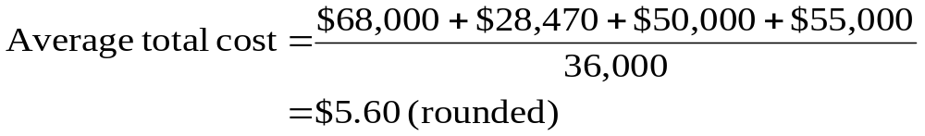
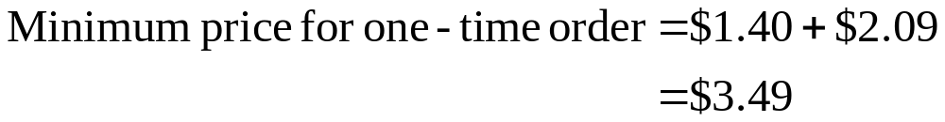
14: Average vs. marginal cost

Slide 16
15: Contribution margin
Jack’s Custom Kars manufactures motorized toy cars for children aged 3 to 6. Jack’s sells these cars for $320 each. The company has fixed monthly expenses of $1,500. The variable cost per car is $212. During an average month, Jack’s sells 20 of these toy cars.
What is the contribution margin per car sold?

Slide 17
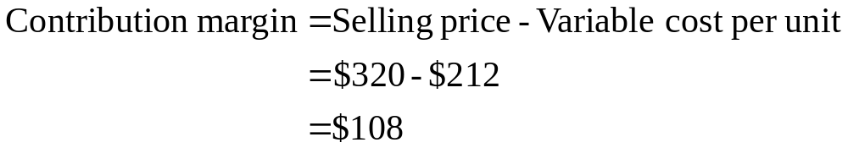
16: Contribution margin

Slide 18
17: Accounting break-even
You are considering a new project. The projections include a sales price of $11.99, fixed costs of $7,500, depreciation of $2,400 and variable costs per unit of $6.20. Ignore taxes.
What is the accounting break-even level of production?

Slide 19
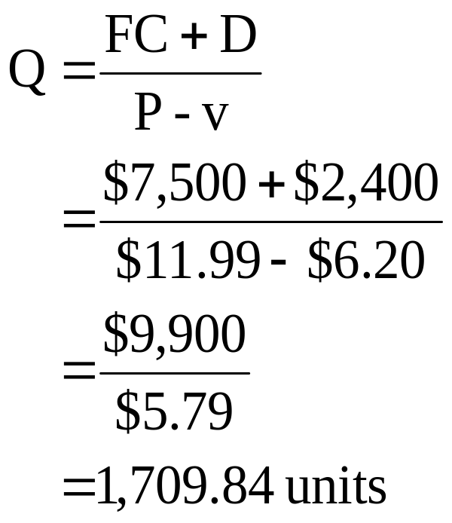
18: Accounting break-even

Slide 20
19: Accounting break-even
Katie’s Kites is considering a project with estimated fixed costs of $2,100, depreciation expense of $900 and a sales quantity of 2,500 units. Ignore taxes.
What is the contribution margin per unit if the projected level of sales is at the accounting break-even point?

Slide 21
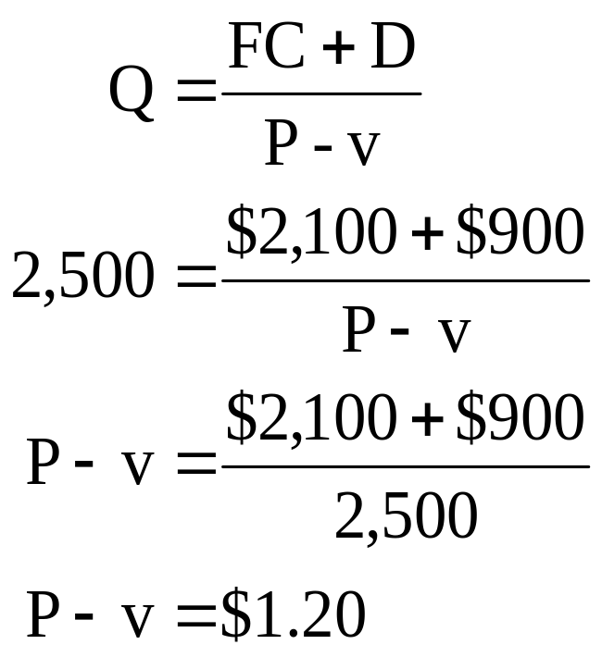
20: Accounting break-even

Slide 22
21: Cash break-even
Pretzels N’ More is considering adding a new retail outlet. Fixed costs are estimated at $160,000 per year. The forecasted sales price is $1.59 per pretzel. Variable costs per pretzel are $.79.
What is the cash break-even point for this new retail outlet?

Slide 23
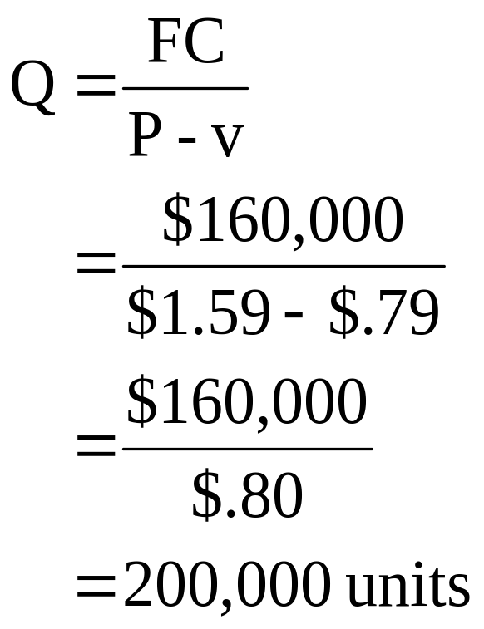
22: Cash break-even

Slide 24
23: Cash break-even
Tight-Wad Willsen is reviewing a proposal that has fixed costs of $12,500, depreciation expense of $5,400 and a contribution margin of $2.05.
Willsen wants to know how many units of this product will have to be sold so that his potential loss is limited to his initial investment. What should you tell him?

Slide 25
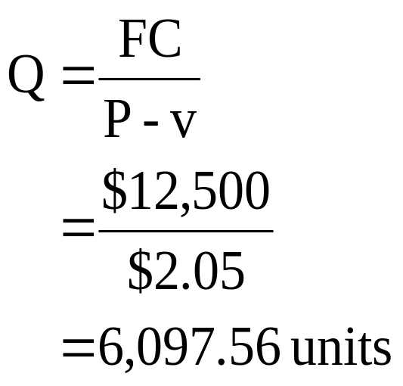
24: Cash break-even

Slide 26
25: Financial break-even
You are considering a new project that has an operating cash flow of $22,600 when the net present value is equal to zero. At that level of sales, the selling price per unit is $14.95, the variable cost per unit is $8.60 and the fixed costs are $19,000.
What is the financial break-even sales quantity?

Slide 27
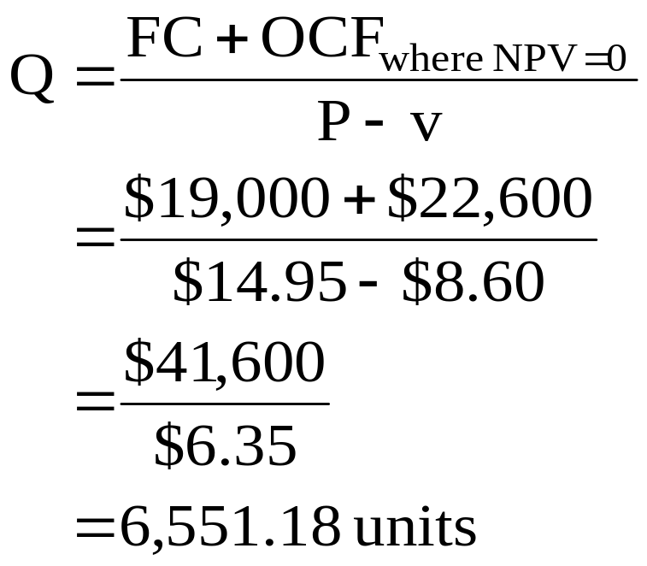
26: Financial break-even

Slide 28
27: Degree of operating leverage
A project has fixed costs of $2,500 and variable costs per unit of $10.15. The depreciation expense is $1,100. The operating cash flow is $6,400.
What is the degree of operating leverage?

Slide 29
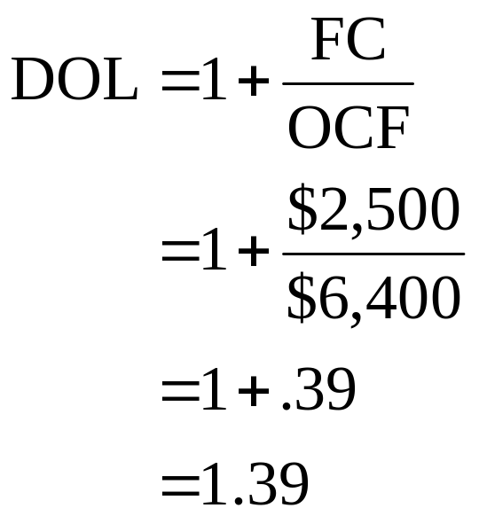
28: Degree of operating leverage

Slide 30
29: Degree of operating leverage
Martha’s Linens, Etc. has a 2.5 degree of operating leverage. Sales are expected to increase by 4% next year.
What is the expected percentage change in operating cash flow for next year?

Slide 31
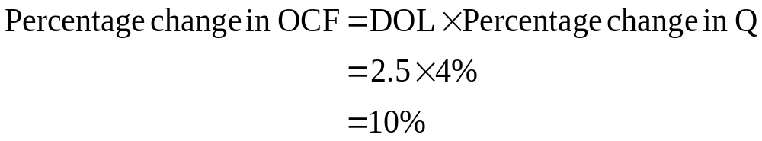
30: Degree of operating leverage

Slide 32
11
End of Chapter 11

